Slide 1

Play store app reviwew analysis
Capstone project 1

Slide 2
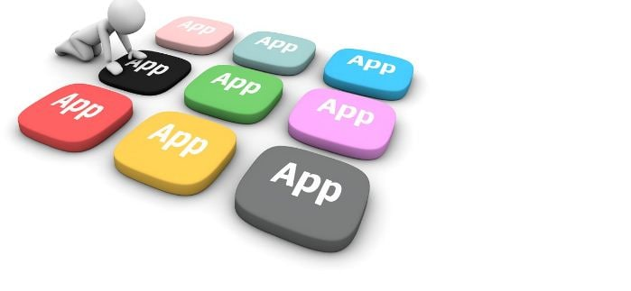

Slide 3
Team members
Deepankar singh
Dhruv Dubey
Sanket Kamble
Pratikisha Chimankar
Komal Sursawant

Slide 4
Contents
Introduction
Objectives
Problem statements
Description of data
Cleaning of data
Data analysis and visualization
conclusion

Slide 5
Introduction
Google play store was launched on March 6, 2012,its objective was to connect Android Market marketing to the Google’s digital distribution strategy
As we know that google play store apps is the biggest market for Android app because of more than 5 millions application with more than 3 billion active users in more than 190 countries.

Slide 6
Objectives
Find the most popular and trending apps
Analyse the Reviews, Rating, Sentiments of people towards various apps .
Find how small changes or update impacts on app performance
Understanding Consumer behaviour and demand ,how they react with different genres of Google Playstore Apps

Slide 7
Problem statements
* What are the top categories on play store?
* How importance is the rating of application?
* Most percentage of content on play store?
* Which category has the most number of installation?
* Check correlation
* How are reviews and rating co-related?
* Mostly used words on play store reviews?
* Relationship between content Rating in Free and paid apps?
* What are the sentiments across database?
* How size impacts on installation of apps?

Slide 8
Description of dataset
Playstore data:-
App: name of the application
Category: category of application
Rating : rating given to the application
Reviews: Number of reviews given to the Application
Size : Size of the application
Installs: Number of downloads of the Applications
Type : Free or Paid
Price : Price of the applications

Slide 9
Description of Dataset
Content Rating : it is related to the age of consumer
Genres : Types of Genre of the Application on the playstore

Slide 10
2.User Reviews data:
App: An app name
Sentiments: Sentiment given to an apps by consumer
Sentiment polarity: The polarity of sentiments measures how negative and positive the context is.
Sentiment subjectivity: The subjectivity of sentiment is how likely that sentiment is to be based on data or factual information.

Slide 11
Data cleaning
This is the most important part of project.Validate and cleanse the data is the essential for eliminating inaccurate data and completing gaps. Here are several key duties
deleting unnecessary data completing blank values.
In the given application, a dataset might contain duplicate values we need to remove it.

Slide 12
Data cleaning
Data cleaning step:
Removing unwanted value: Removal of duplicate / invalid values.
Handling missing values: dealing with missing values in our data base.
Filtering Unwanted outliers: Removing incorrect or unwanted outliers.

Slide 13
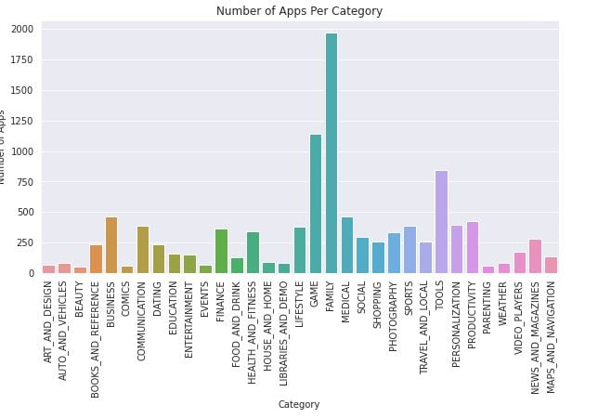
Data Analysis & visualization maximum number of apps in different category
From the above graph,we can conclude that Family category has highest number of apps in playstore.
Family which category has maximum apps in play store more than 1950
Also top 5 category, which has the large number of apps in playstore are Family,Game,Tools,Business, Medical

Slide 14
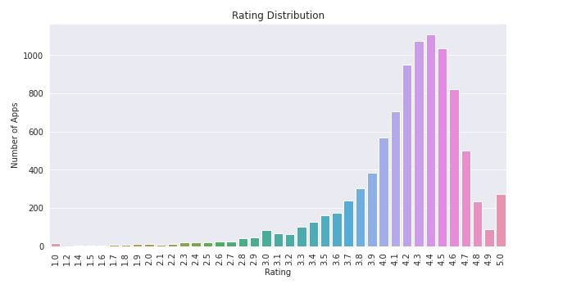
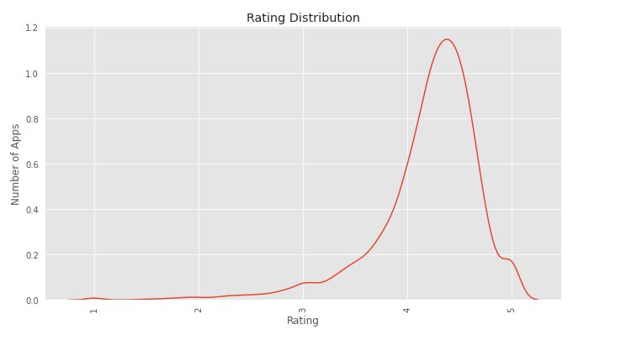
Data Analysis & visualization rating distribution of apps installed on playstore.
As we can see clearly from above bar graph that approx more than 1100 apps have a 4.5 rating. And
According to the below diagram most of the apps is highly rated and less number of apps is low rated . 4.4 is highest number of apps rating

Slide 15
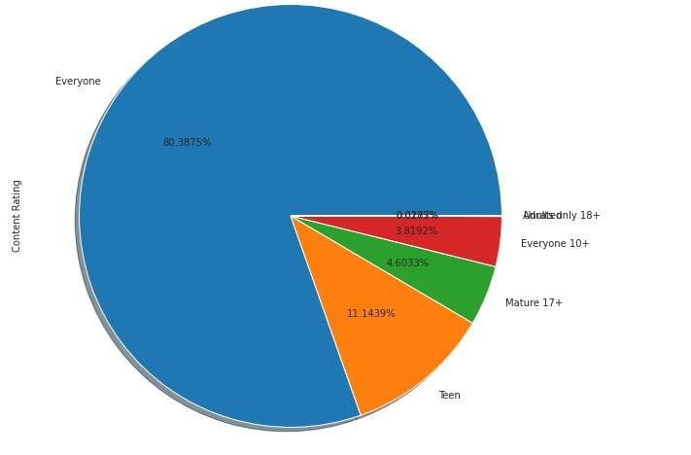
Data Analysis & visualization max. percentage of content on playstore
From the above pie chart we can conclude that most of the apps installed on the playstore is for everone group with 80%(approx) ,followed by Teen, mature17+,etc

Slide 16
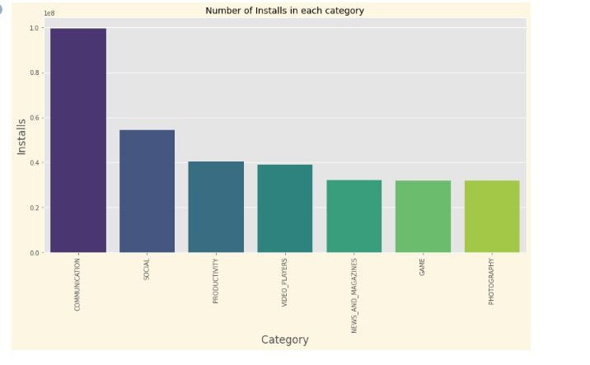
Data Analysis & visualization max. number of Installs of apps by consumer in category
From the above graph we can conclude that a large number of installation is done by consumer in communication category ,followed by social ,productivity,etc.
This means that most of the consumer likes the communication apps .So,developers needs to make more apps in this domain.

Slide 17
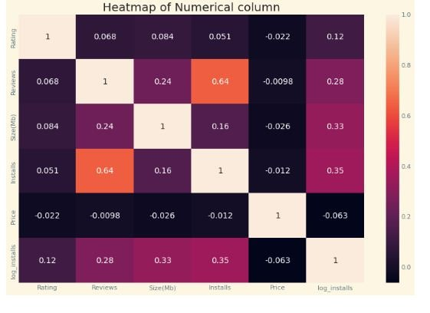
Data Analysis & visualization
There is a strong positive correlation between the Reviews and Installation
The price is negatively correlated with Rating,Reviews, and Installs.

Slide 18
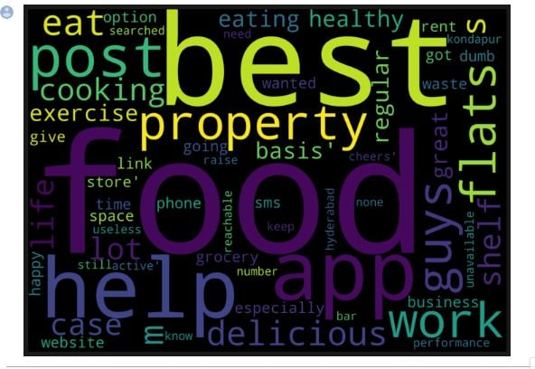
Data Analysis & visualization
Mostly used words on playstore reviews
Here ,food,best,app,help,work words are used most of the times by the consumer in reviews.
So,we can conclude that most of consumer like food domain apps according to their search on playstore. Therefore if developer works in this domain then there is a high chance of success of any apps.

Slide 19
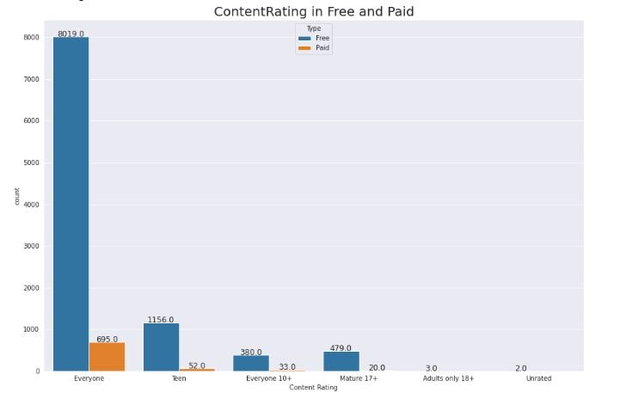
Data Analysis & visualization content rating in free and paid
From we can conclude that ,most of the consumer given the maximum rating in free apps of everyone category than paid apps.
Everyone category has maximum number of paid apps compaired other category paid apps.

Slide 20
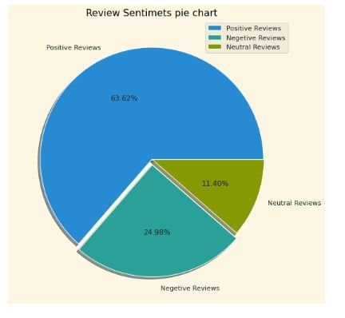
Data Analysis & visualization overall percentage of review sentiments
Most of the sentiments reviews given by the user are positive with 63.62%
But also there is a negative sentiments percentage of 24.98%
This mean developer had to do their hardwork to change this negative sentiments into positive or neutral.

Slide 21
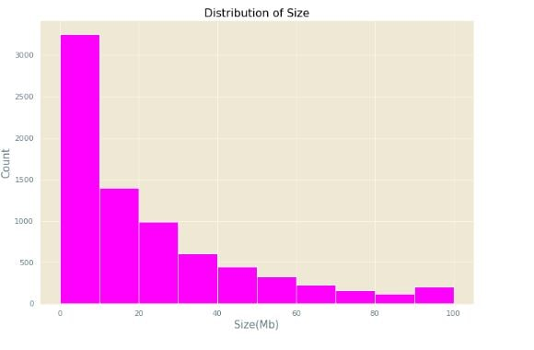
Data Analysis & visualization size of most of the apps installed on playstore
Here, we can say that high number of apps which are installed on playstore are between 0 to 20 Mb size
This means that if the size of apps is less than 20 MB size then it is very high chance to downloading that apps.

Slide 22
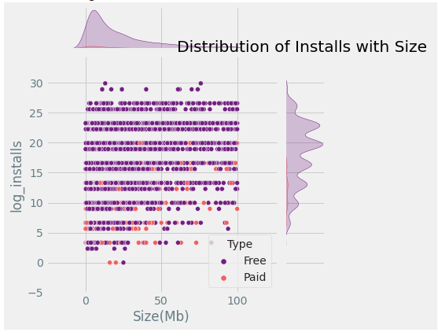
Data Analysis & visualization
Distribution of Installs with Size
Above plot clearly indicates that size of apps are directly impact on number of instllations. Apps of bigger size are less installed.

Slide 23
conclusion
Percentage of free apps is higher than paid apps
Percentage of apps,installed on playstore , in family category is higher than other category.
There is a strong positive correlation between the Reviews and Installation
The apps whose size is less than 20 MB has a high chance of downloading that apps by consumer.
Price is negatively correlated with the rating, reviews and installation.

Slide 24
Challenges Faced
Huge chunk of data was to be handled on our first project when we have not any experience or do not know how to handled ,where to start,where to end.
Computation time

Slide 25

Yayyy!!! This is the end of our story. Hope you enjoyed this journey. In this, we have seen How every feature has a unique impact on the story .!!!

